Slide 1
Joseph daniel SMBS VIT CC
WORK AND HEAT TRANSFER

Slide 2
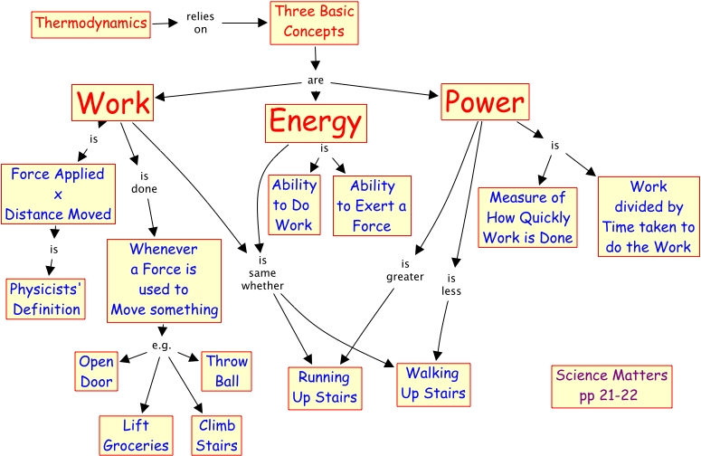
Basics

Slide 3
Interaction between a closed system and its surroundings can take place in two ways
1) Work Transfer
2) Heat Transfer.

Slide 4
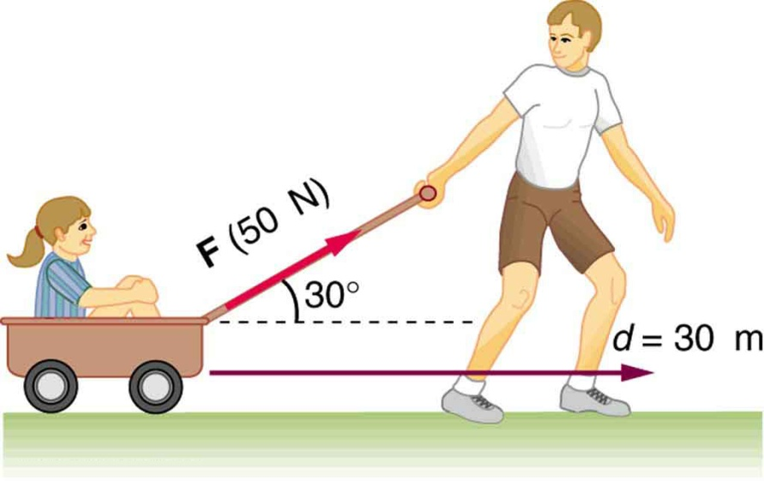
Work defined..
Work is the Energy transfer associated with a force acting through a distance.
Rising piston, rotating shaft, electric wire crossing system boundaries are examples of work interactions.
Work is a form of energy transferred like heat and hence can have something similar to energy units like kJ
Work done per unit time is called power (W)

Slide 5
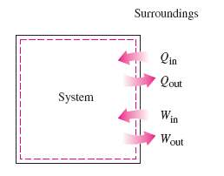
Sign conventions
Heat transfer to a system and work done by a system are positive.
Heat transfer from a system and work done on a system are negative.
Heat rejected by a system of 10 kJ is represented as Q = -10 kJ or Q_{out} = 10 kJ.
Work input of 10 kJ can be represented as W = -10 kJ or W_{out} = 10 kJ.

Slide 6
Thermodynamic definition of work
Energy can cross over system boundary only by work or heat.
It is defined as the energy transferred because of property difference other than temperature that exists between the system and surroundings.
Eg: Displacement of piston in a cylinder arrangement.
If the piston moves to a finite distance, the work done by the system is evaluated by the integrating between the operating limits.
Unit of work (or work transfer) is joule, J.

Slide 7
Salient aspects of work
Work is energy in transit and can be identified only when the process is being executed. It does not exist either before or after the interaction.
It is a boundary phenomenon. Work cannot be possessed or stored by the system.
It is something that happens to the system but it is not a characteristic of the system.

Slide 8
Pdv work is valid only when the system is closed, process is quasi static, no viscous effect, effects due to gravity and magnetization are negligible.
Sign convention for Work:
Done by the system: Positive (+W)
On the system: Negative (-W)
When a system does a positive work the surroundings do an equal number of negative work. And the converse is also true.
W_{system}+W_{surroundings} = 0

Slide 9
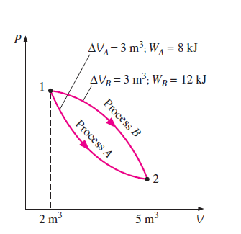
Exact and Inexact differentials
Properties are point functions meaning that they are dependent upon state only and not on how a system reaches the state.
Hence they have exact differentials. (denoted by d)
Attainment of state 2 can be through any path and hence the route determines the Pdv work.
Hence it is inexact differential denoted by (del)

Slide 10


This is the case for volume change only, exact integrals are applicable for point function (volume)
However for work the attainment to the final state can be through process A or B which tantamount to an inexact differential
Work is not a property possessed by the system at any state.

Slide 11
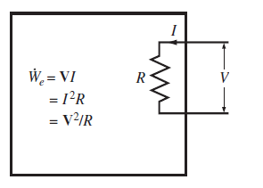

Electric work
In an electric field, the electrons in the wire moves under the influence of the emf doing work.
‘I’ electrons move through a potential difference ‘V’
W_{e} = V.I

Slide 12
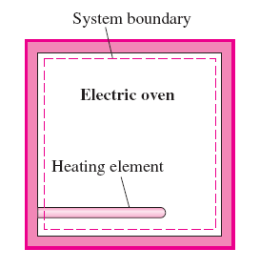
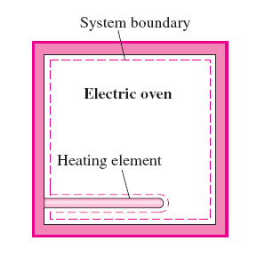
Electric oven case

Slide 13
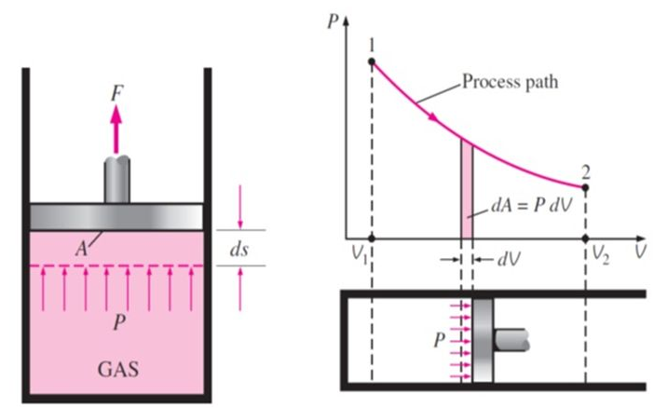
Displacement work

Slide 14
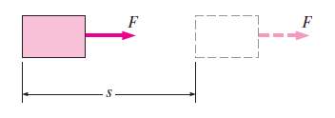

Mechanical forms of work
Work done by the constant force F on the body is displaced by a distance ‘s’ in the direction of the force, and is given by
W = F.s (kJ)
When Force applied is not constant.

Slide 15
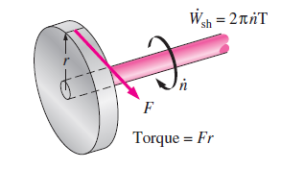



Shaft work
and
then
Constant Force that produces the required torque
Applications: Machineries and moving vehicles.

Slide 16
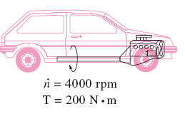
Determine the power transmitted through the shaft of a car when the torque applied is 200 N.m and the shaft rotates at a speed of 4000 rpm.
Determine the power required to accelerate a 900 kg car from rest to a velocity of 80 kmph in 20 seconds.

Slide 17
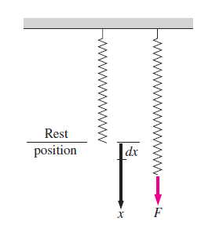



Spring work
Length of a spring changes with application of force.
‘K’ is spring constant
‘x₁’ and ‘x₂’ are initial and final displacement positions

Slide 18

HEAT
Is a form of energy that is transferred across the boundaries of a system.
Due to temperature difference between system and the surroundings.
No heat interaction if both the system and surroundings are in equilibrium.
Sign convention: Heat transfer to the system is positive and heat transfer from the system is negative.

Slide 19
Heat and internal energy ??
Are they the same?
Internal energy is a property, heat is not.
Internal energy is associated with a state whereas heat is associated with a process.
Heat is energy in transition

Slide 20
In common terms
Heat Flow
Heat addition
Heat removal
Heat storage
Waste Heat
Process Heat
Heat of reaction
Specific Heat
Sensible and Latent heats

Slide 21
Comparison of heat and work
Both heat and work are path functions, they are not properties of the system.
Boundary phenomenon: as they represent energy crossing the boundary.
Energy interactions occur only when a system undergoes a change of state.
Both are something that happens to the system and not the characteristic of the system.
Associated as a process

Slide 22
Dissimilarities
A stable system cannot have work transfer, no such restriction is there for heat transfer.
Heat is energy interaction due to temperature difference only.
Heat is a low grade energy whereas work is a high grade energy

Slide 23
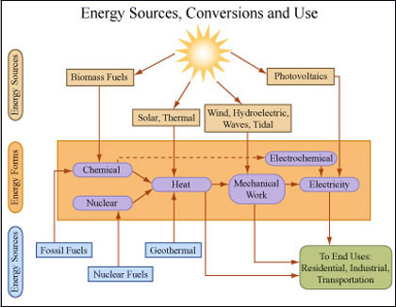
HEAT AND WORK INTERACTIONS

Slide 24
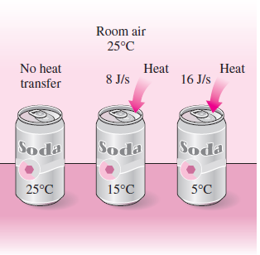
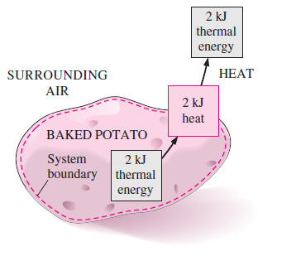
Examples of heat transfer
Higher the temperature difference, higher is the rate of heat transfer
Transferred heat becomes a part of the surroundings as internal energy

Slide 25
Heat Transfer can happen by
Conduction: which is the transfer of energy from the more energetic particles of a substance to the adjacent less energetic one as a result of interaction of the particles.
Convection: Transfer of energy from a solid surface and the adjacent fluid that is in motion.
Radiation: Transfer of energy due to emission of electromagetic waves.

Slide 26
Specific Heat
The quantity of heat received or rejected by a system during a process of heating or cooling is measured as a product of mass,specific heat and temperature differences.
Q= m*C_{p}* (T₁-T₂)
Where C_{p} is the specific heat capacity.
Specific heat capacity is the quantity of heat that enters or leaves a unit mass of the substance when it experiences 1 degree change in temperature.

Slide 27
Specific heat at constant volume (C_{v}): is the amount of heat added at constant volume to change the temperature of the unit mass of a gas by 1 degree.
Specific heat at constant pressure (C_{p}): Heat addition at constant pressure.
For Water c = 4.186 kJ/kg.k
For Air c_{p}= 1.005 kJ/kg.k and c_{v}= 0.718 kJ/kg.k

Slide 28
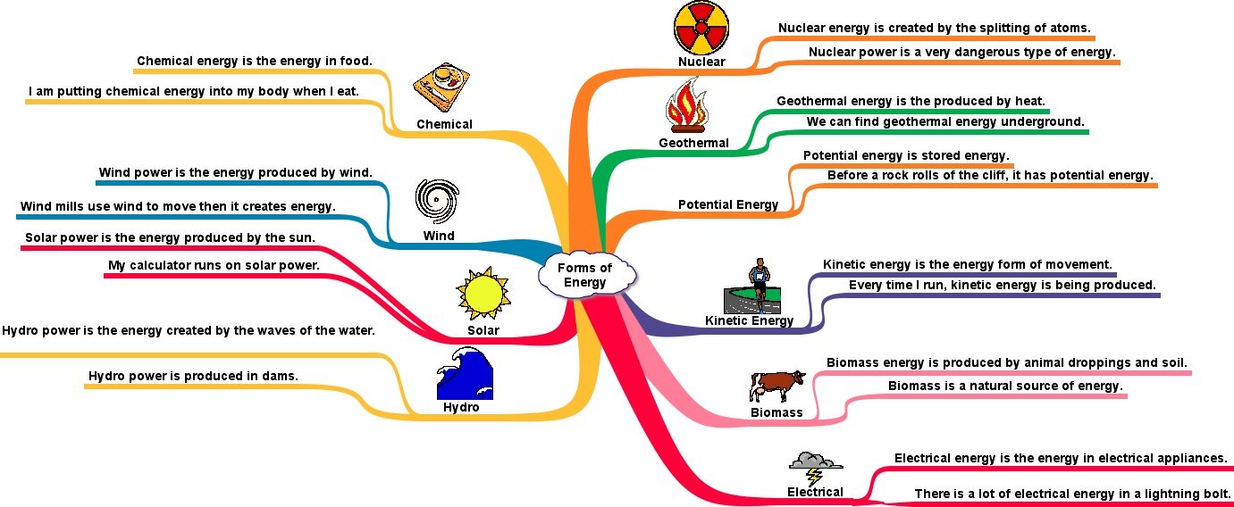
Forms of energy
Thermal
Mechanical
Kinetic
Potential
Magnetic
Nuclear

Slide 29
Some facts
Thermodynamics provides no information about absolute value of total energy.
It gives an idea about change of total energy.
Two groups i.e., macroscopic and microscopic.
Macroscopic energy is the energy which a system possesses as a whole with reference to an outside reference frame. Eg: PE, KE
Microscopic energy is the energy with reference to the molecular nature of the system and molecular activity

Slide 30
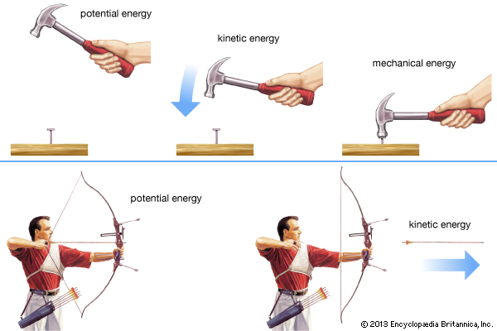

Kinetic and potential energies
The energy a system possesses as a result of motion with reference to some reference frame is called Kinetic Energy.

Slide 31


The energy that a system possesses as a result of elevation in the gravitational field is called as potential energy.

Slide 32
Closed systems remain stationary during a process and experience no change in PE and KE, such systems are also called as stationary systems.
The change in total energy is identical to the change in internal energy alone.
If fluid flow is to be considered, mass flow rates which is the amount of mass flowing through a cross sectional area per unit time is taken into account

Slide 33
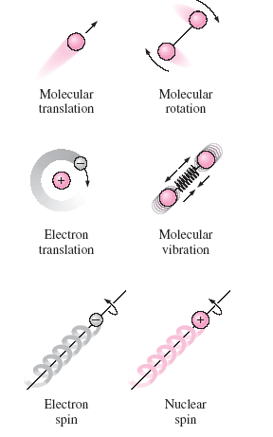
Internal energy
The portion of the internal energy of the system associated with the kinetic energies of the molecules are called as sensible energy.
The internal energy is also responsible for the binding forces between molecules of the substances, within an atom and nucleus and so on.

Slide 34
The internal energy associated with the phase change of a substance is called as latent energy.
Phase change may occur with out the change in chemical composition of the system.

Slide 35


Mechanical energy
Used to transport fluids from one place to another at a particular flow rate, velocity etc.
Mechanical energy can be defined as the form of energy that can be converted to mechanical work completely and directly by an ideal mechanical device such as an ideal turbine.
No heat transfer or energy conversion is expected.
KE and PE are forms of mechanical energy

Slide 36
Problems
A mild steel piece of 5 kg mass is heated to 115ºC and is dropped into an insulated vessel containing 30 kg of water at 20ºC. Due to the heat flow from the hot mild steel piece, the rise in temperature of water is measured to be 3.5ºC. Calculate the specific heat capacity of the mild steel.

Slide 37
It is proposed to heat 2 liters of water which is initially at 15ºC to a temperature of 80ºC. What time will be required to achieve this objective if a 0.5 kW electric heater is available for this purpose.
Assumptions: No other heat transfer with the surroundings
Specific heat capacity of water : 4.187 kJ/kg.k

Slide 38
A car of 1.5 tonnes is running at a speed of 60kmph. The brakes are applied by the driver and the car is brought to rest. Calculate the rise in temperature of the brake material if its mass is 15 kg.
Assume the specific heat of the material of the brakes is 0.46 kJ/kg.k.

